Slide 1
Linux Utility Lab
LINUX AS A REAL TIME OS

Slide 2
Real Time Operating System(RTOS)
Processes real-time application data
Jitter
Categorised as “soft” and “hard”
Frequently used when OS is dedicated to a specific task

Slide 3
..Continued
Valued on speed and predictability
Minimum thread switching latency
Minimum interrupt latency
Guarantees consistency, not excellent throughput
Priority Preemption and RR scheduling

Slide 4
“HARD” VS. “SOFT”
Use of Deterministic algorithms
    Soft RTOS “generally” meets deadline
    Hard RTOS “deterministically” meets deadline
Hard: Missing deadline = system failure

Slide 5
“Vanilla” Linux Scheduler
Tasks are always put in run queues
First In First Out(SCHED_FIFO)
Round Robin(SCHED_RR)
SCHED_NORMAL | SCHED_OTHER

Slide 6
PREEMPT_RT (-rt)
Brainchild of Ingo Molnar(Redhat)
Push-Pull stratergy
  Where to place tasks optimally on wakeup
  Lower priority task that is on a run-queue running a higher priority task on wakeup
  Preemption by a waking up higher priority task
  When tasks lower their priority
Independent of the load-balancing of the CFS

Slide 7
Installation
Get the sources:
  kernel.org/pub/linux/kernel/
  Corresponding RT patch: kernel.org/pub/linux/kernel/projects/rt/
Since the project is still highly developed as a beta, might not work correctly with every provided version.
TIP: Use Kernel version 3.12.9 with patch: 3.12.9-rt13

Slide 8
Patching the source
Extract the source from the tarball:
  $ tar xJf linux-3.12.9.tar.xz
Switch the active working directory to the kernel source directory:
  $cd linux-3.12.9
If patch is in gzip format:
  $zcat /path/to/patch | patch -p1
If patch is in bzip2 format:
  $bzcat /path/to/patch | patch -p1
Patch – utility used to apply diffs to files. `man patch` for more info

Slide 9
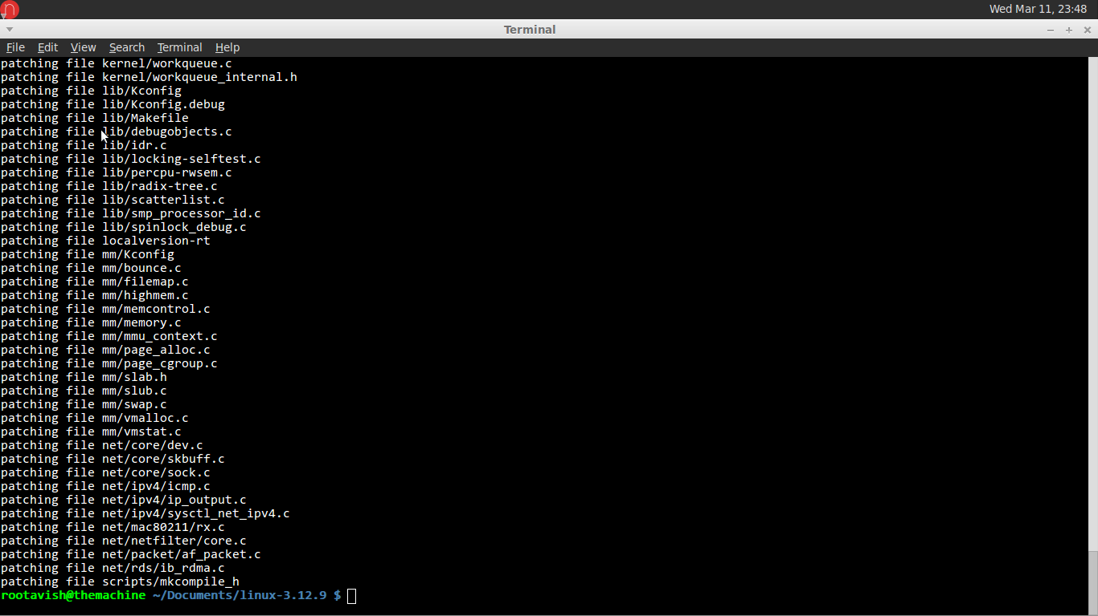
Screenshot of patch output

Slide 10
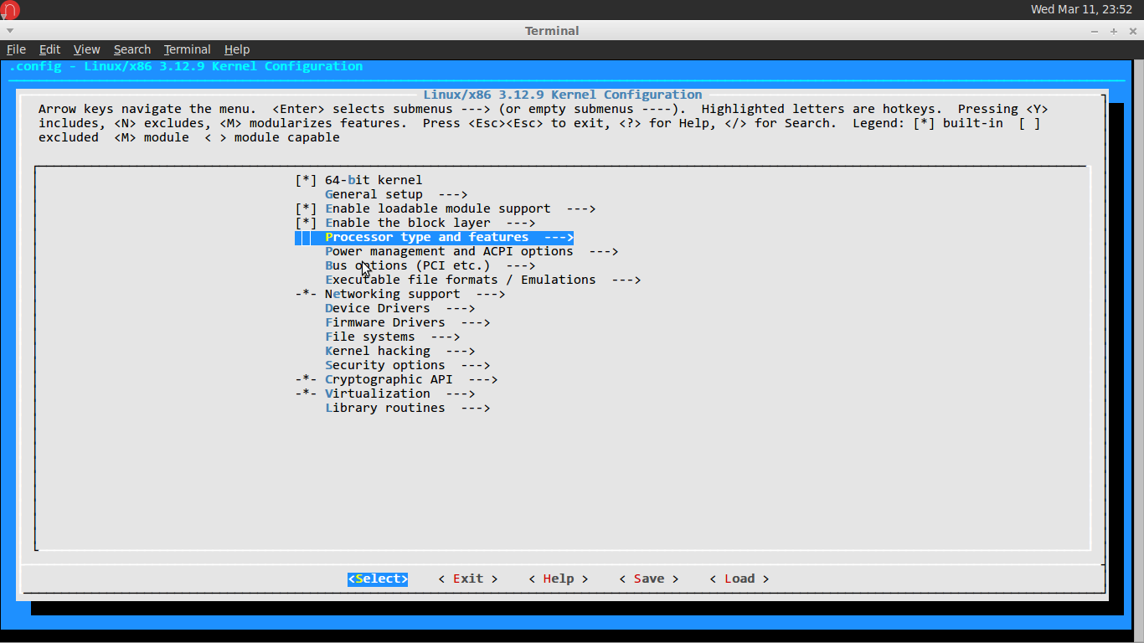
Configuring the Kernel
Configure the kernel:
  $make menuconfig

Slide 11
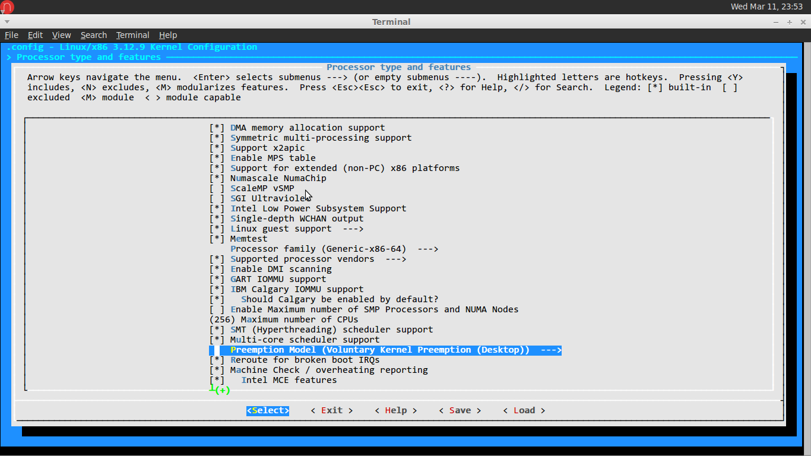
..continued

Slide 12
..continued
Continue with the rest of the installation as always.
$make
$make modules
#make modules_install
#make install
Note: The .initrd.img is created as a part of install and does not need to be created explicitly.
TIP: The rt-kernel will take over two hours on average to compile and will create over ~9GB of objects. Make sure to not run out of disk space.

Slide 13
Post install
Check that you are, in fact running the new kernel
$uname -r
Kernel version will have -rt appended to it
Check that the new interrupts have been registered under /proc/interrupts
$cat /proc/interrupts

Slide 14
..Continued
Check the output of `dmesg` for the softirq messages
Check the output of
  $ps ax
to verify that IRQ's are now running as kernel threads.
IRQ = Interrupt Request

Slide 15
Thanks!!
  That's all.
                * 12-CSS-16 Avishkar Gupta
                * 12-CSS-18 Bushra Khan

